Slide 1


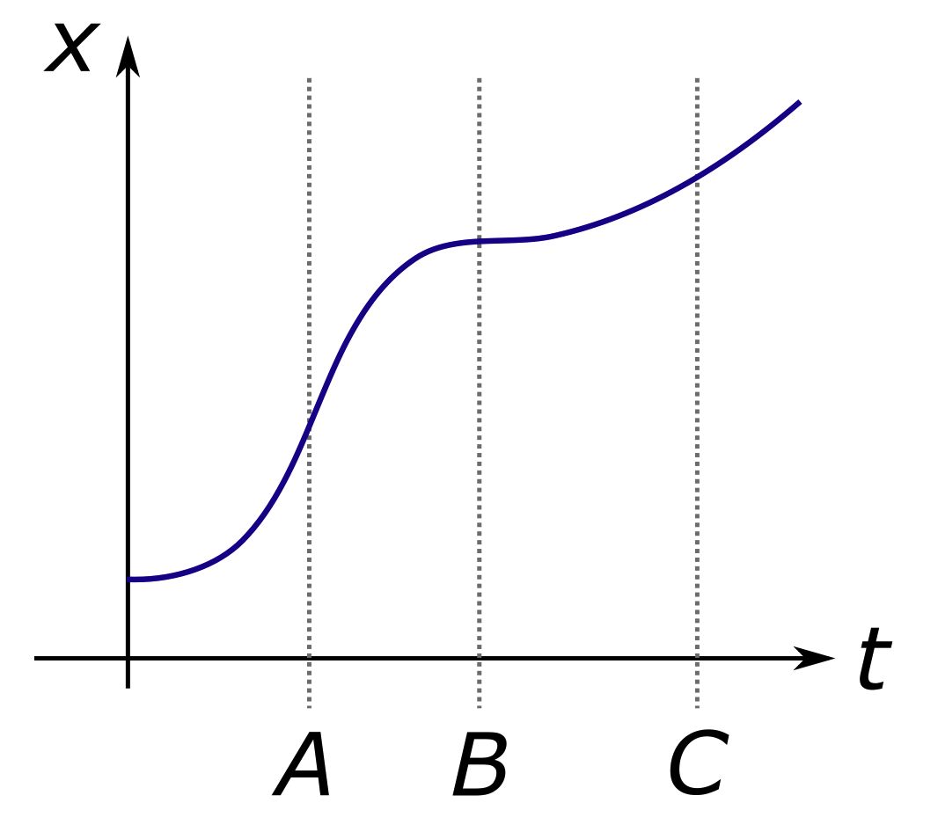
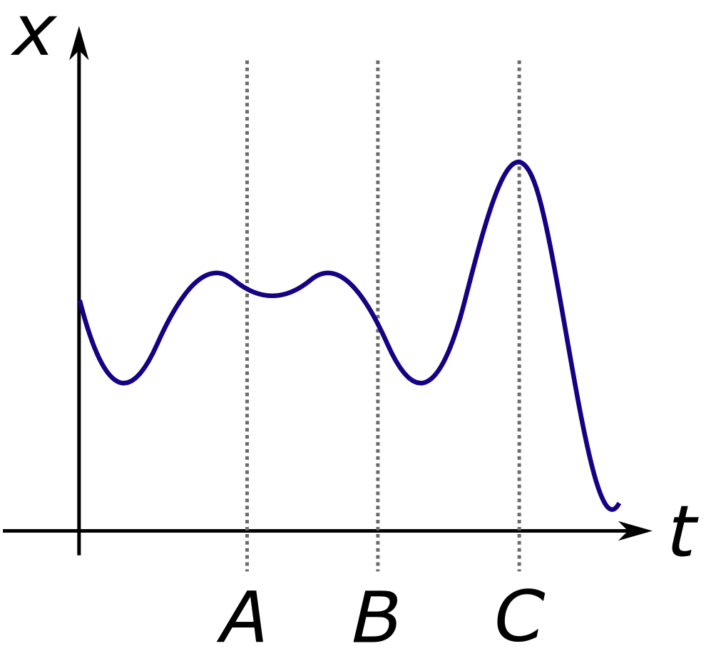
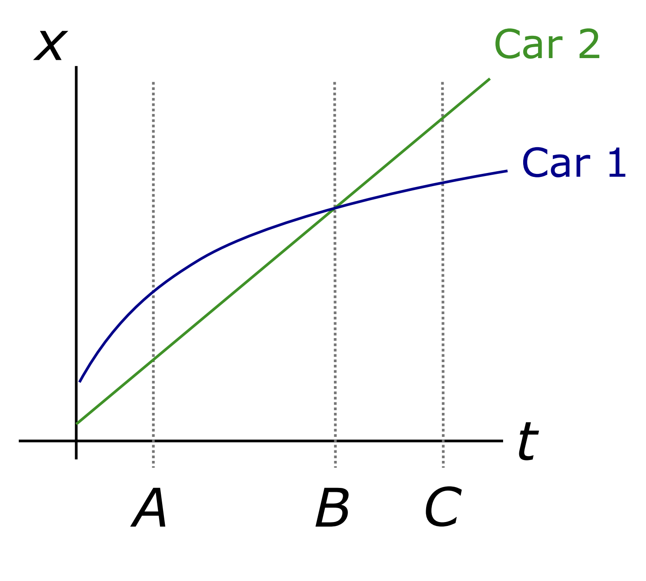
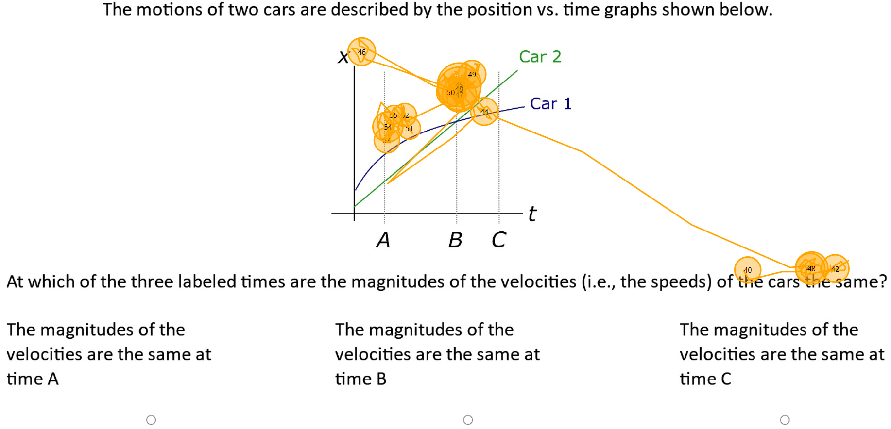
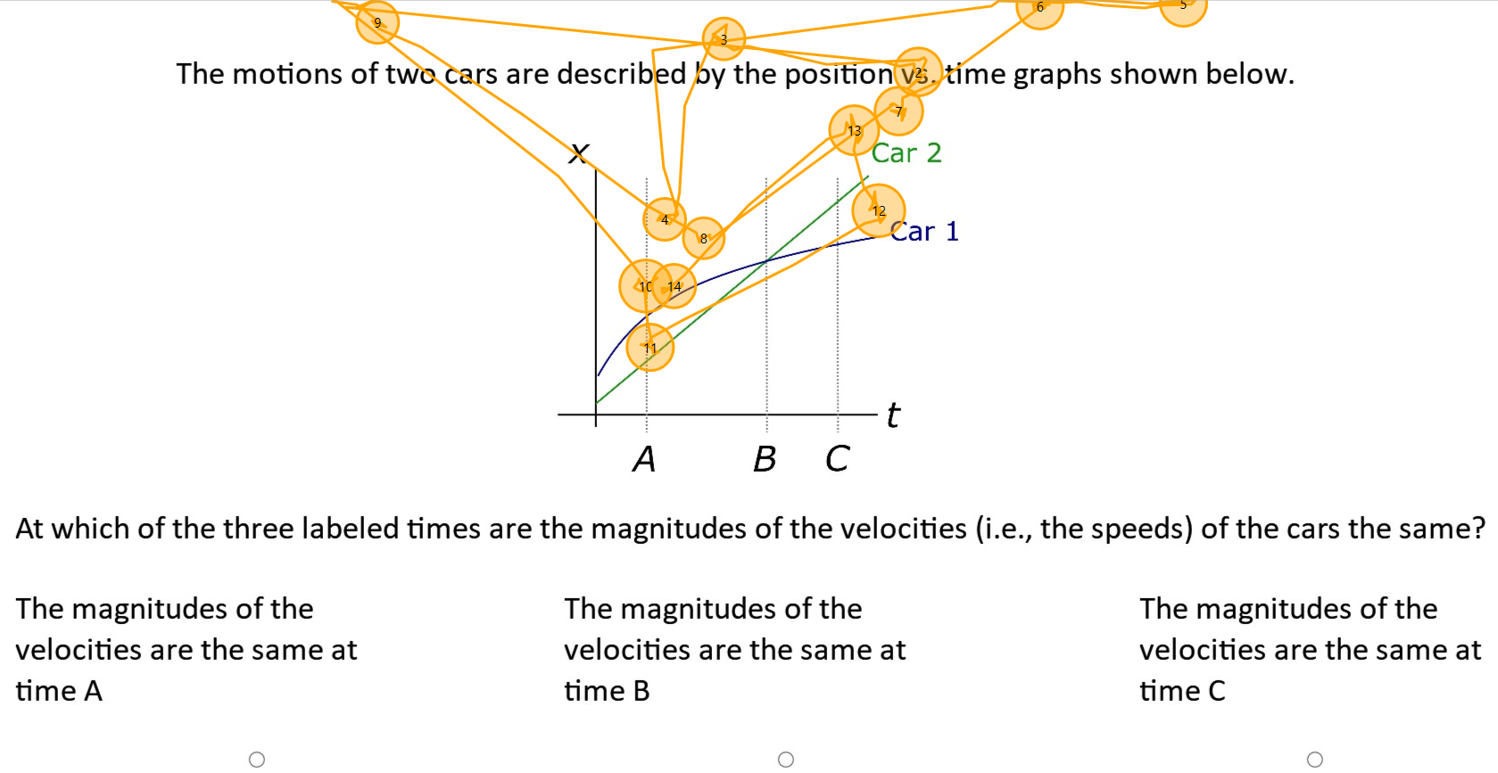

Understanding Student Reasoning in a Kinematic Graphing Task Using Eye Tracking
Christopher Omar Gamboa, Drew J. Rosen
1.) Background
3.) Research Questions
4.) Methodology
Understanding vs Reasoning in Physics
Studies have shown that while students may have the requisite knowledge and skills (mindware) to solve a physics exercise, they may not apply it in an analogous problem.^{[1-4]}
RQ1: What are the student reasoning pathways when solving the KGT?
RQ2: What is the role of system 2 in answering the KGT correctly?
RQ3: What is the relationship between students eye movements and their responses to the MCQs?
Eye Tracking
Student gaze was analysed, qualitatively, for patterns into reasoning pathways. An iMotions 60Hz Smart Eye Aurora Eye Tracker^{[13]} was used to track real time student visual attention.
Meta Cognitive Questions ^{[9]}
Students (N=16) were asked a series of verbal questions which asked them to reflect on the mindware used to solve the exercise.
Kinematic Graphing Task (KGT)
The motion of a car is described by the position vs. time graph below:
The motions of two cars are described by the position vs. time graphs shown below:
5a.) Eye Tracking for Student A
5a.) Eye Tracking for Student B
At which of the three labelled times is the magnitude of the velocity (i.e., the speed) of the car the greatest?
At which of the three labelled times are the magnitudes of the velocities (i.e., the speeds) of the cars the same?
~82% students get both correct, of whom ~60% got this correct ^{[3,4]}
2.) Theory
Dual-Process Theories of Reasoning (DPToR)
DPToR are a theoretical framework used to model why students exhibit this behaviour. Reasoning pathways are modelled as using two systems, each with separate duties that are called upon to preform different tasks.^{[5]}
5b.) Metacognitive Responses for A
5b.) Metacognitive Responses for B
“I noticed like the on B parts that both are crossing. But I quickly found out that this is not B because it’s just about the derivative, not about the position."
“The first thing I did was, actually before even reading the header of the question was just jump straight to the graph ... And I see it’s a distance time graph. And immediately I remember back to like sort of middle high school days when we were told, oh the gradient represents the speed. And the reasoning behind that is that dx by dt is one way you can get speed. And so I looked at those three. Then I read the question underneath, which says, which three of, which of the three time are the magnitudes the same? So I’m thinking, okay, well direction doesn’t matter. We’re just interested in kind of the size of the slope. And I looked at the three points and I started at A because it’s on the left and I read from left to right and it looks about the same. But I checked the others just in case. It’s definitely different at B, definitely different at C. So I picked A and I’m pretty sure that’s correct.
System 1:
The quick, automatic, and unconscious system that, when faced with a problem, generates a provisional model.
System 2:
The slow, effortful, deliberate, and conscious system that, when activated, evaluates the provisional model generated by system 1.
6.) Conclusions
DPToR in Physics Education Research
Previous work in Physics Education Research has been focused on understanding the reasoning pathways through the use of interventions and think aloud interviews. New studies have begun to focus on eye tracking and metacognitive reflexive interviews.^{[6-9]}
Eye tracking can show whether students considered the common incorrect answer choice before answering the KGT correctly
We observe that while some students avoid the SDF, most students must activate system 2 and override the intuitively appealing answer to answer the KGT correctly
Interpretations of eye tracking data is generally consistent with students’ self-reported MCQ responses
Metacognitive Questions (MCQs)
MCQs are a series of reflexive questions that allow students to self-report on the reasoning pathways tested while solving the exercise. ^{[10]}
7.) Future Work
Salient Distracting Features (SDFs)
SDFs are task-irrelevant features which are perceived as relevant and may cue incorrect lines of reasoning. These features often dominate visual attention but may be ignored with practice and experience.^{[11, 12]}
Additional work is to be carried out in the fall of 2026 with a significantly larger sample size (N=40-50+)
Revisions to the MCQ’s are to be carried out in an effort to hopefully further insights for the entire reasoning trajectory.
References
[1]Kryjevskaia, M., Stetzer, M., R., Grosz,N., (2014) [2] Kellar, K., Heron, P.,(2025). [3] Heckler, A., (2011) [4] Speirs, J., C., et.al, (2021). [5] Stanovich, K., E., (2009) [6] Fittswood, T., Rosen, D., R., Stetzer, M., R., (2022) [7] Susac, A., et. al., (2014) [8] Sowles, E., Rosen, D., J., Stetzer, M., R., (2022) [9] Madsen, A., M., et. al (2012) [10] Swoles, E. (2026) [11] T.K. Lê, (2017) [12] Gaspelin, N., Luck, S., (2017) [13] iMotions, https://imotions.com/products/hardware/smart-eye-auraora/#product-specifications
Contact
c.o.gamboa@sms.ed.ac.uk

