Slide 1
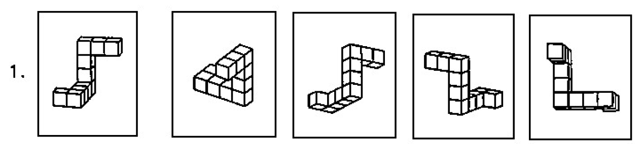
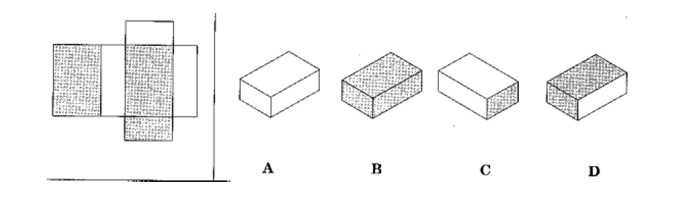
Collaborative project idea:
Resources to support visuo-spatial reasoning for introductory physics students
Visuo-spatial reasoning skills (e.g. 3D visualization from 2D images; mental rotation; sketching simple 3D objects from different viewpoints; sketching 2D projections; object reflection, translation, scaling) are important for many areas of physics.
D. H. Uttal & C.A. Cohen, (2012), Psychology of learning and motivation, 57, 147.
Key for conceptual understanding and problem-solving.
M. Kozhevnikov et al., (2007) Cognitive Science 31 549.
Standardized diagnostic tests exist.
Skills training has led to improvements in engineering students.
S. A. Sorby, (2009) International Journal of Science Education, 31, 459.
Antje Kohnle, SUPA meeting, 20 August 2024

Slide 2
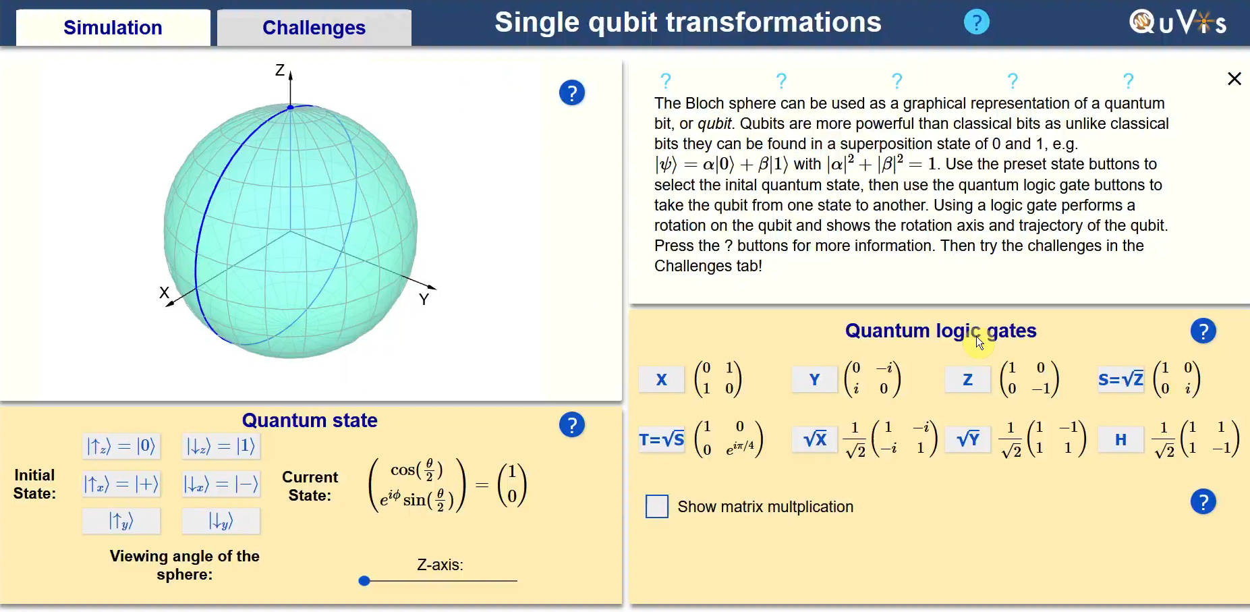
QuVis simulations: use three.js which could be helpful in resource development for visuo-spatial reasoning.
Aim: develop a combination of paper-based sketching tasks and multimedia tasks (e.g. starting with some final year projects)

