Slide 1


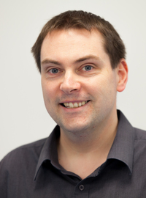
Who he?
Ross K. Galloway
ross.galloway@ed.ac.uk
Professor of Physics Education
School of Physics & Astronomy
University of Edinburgh (since 2009)
previously University of Glasgow

Slide 2
What I’ve been thinking about recently
Pedagogical knowledge
Pedagogical environment knowledge
Pedagogical content knowledge
Content knowledge

