Slide 1

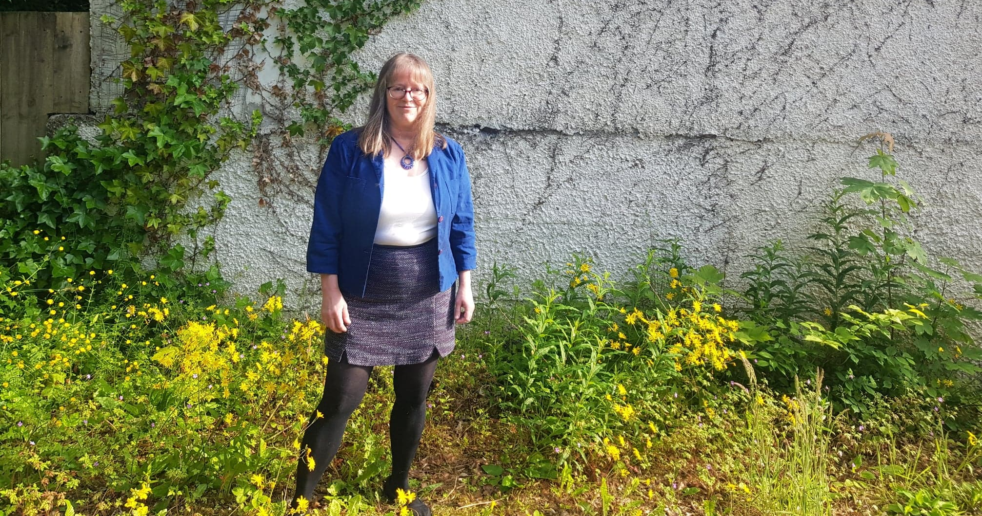
Professor Bonnie Steves – PER profile
Professor of Astrodynamics & Doctoral Education (active retirement)
Experience
Current
Activities
32 years academic at GCU, Astronomy & Applied Mathematics teaching, research; 22 yrs of senior management leadership
18 yrs Director of the Graduate School at GCU
1st female professor of Applied Mathematics & Astronomy in Scotland.
Integral in creating first university-wide Graduate School at a Scottish univ.
Co-creator - UK Researcher Development Framework.
Astronomy teacher, researcher, public outreach
President, Div A Fundamental Astronomy, International Astronomical Union IAU
Author of graduate textbooks (5) & popular astronomy book (2025)
External reviewer/advisor: Graduate Schools, PhD, ProfD, Mres programmes
Director of International Summer Schools in Astronomy (next 2026)
Trustee Scottish Universities Summer Schools in Physics SUSSP
Expert advisor on PGRs with SFC, UKCGE, QAA; on astronomy with HMNAO, Armagh Observatory
Current research areas:
(1) developing researchers thru summer schools in physics & astronomy
(2) Expected outcomes framework for ProfD & PhD programmes in STEM
(3) Training in STEM public outreach and design public outreach programmes

